Slide 1

CSE 6406: Bioinformatics Algorithms
Dr. Md. Shamsuzzoha Bayzid
Department of Computer Science and Engineering Bangladesh University of Engineering and Technology

Slide 2
Contents Courtesy
The contents of this lecture are taken/modified/inspired from the lectures of the following Professors.
Tandy Warnow (UIUC)
David K. Gifford (MIT)
Ben Langmead (Johns Hopkins University)
Mihai Pop (University of Maryland, College Park)
Atif Hasan Rahman (BUET)
2
Notes:
2

Slide 3
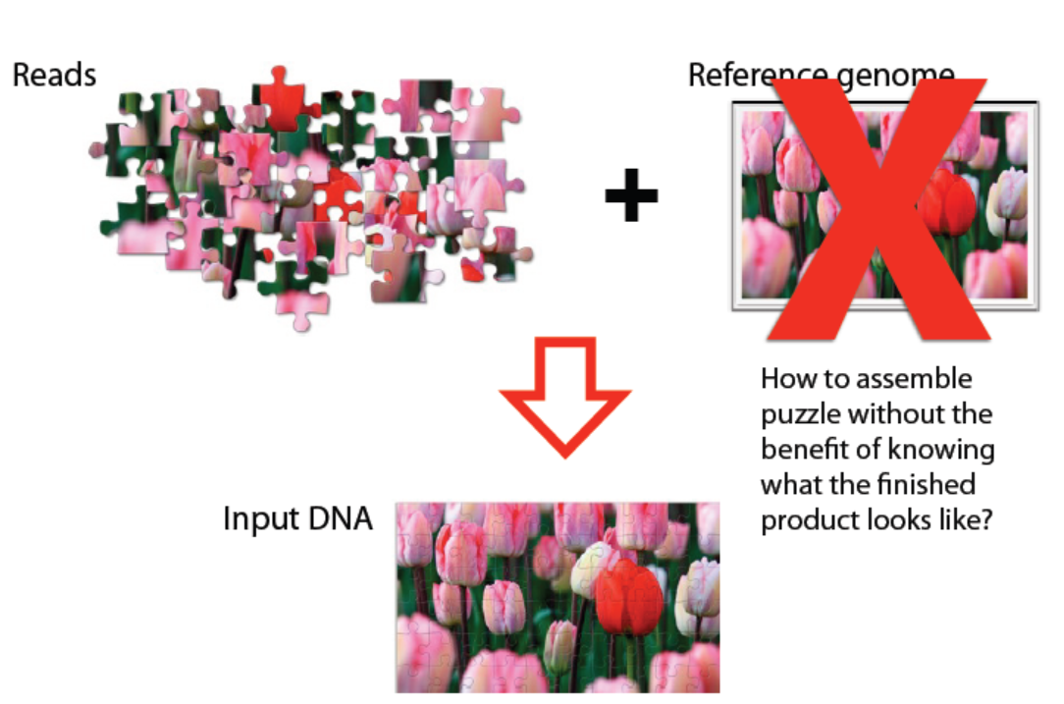
Genome Assembly

Slide 4
De Novo Assembly
How do you combine the short reads to construct a genome?
?
4
Notes:
4

Slide 5
De Novo Assembly paradigms
Overlap Graph:
greedy (TIGR Assembler, phrap, CAP3...)
overlap-layout-consensus methods
graph-based (Celera Assembler, Arachne)
k-mer graph
Construc k-mer graphs from the reads
Original reads are discarded
Especially useful for assembly from short reads
5
Notes:
5

Slide 6
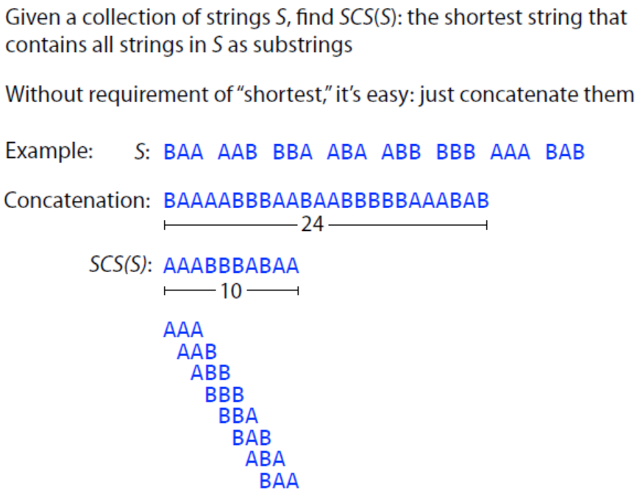
Shortest Common Superstring

Slide 7
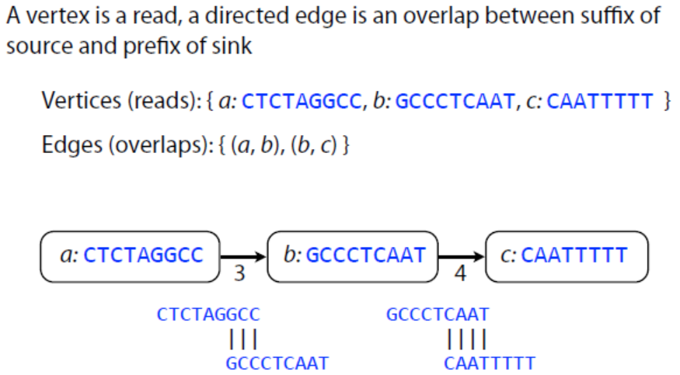
Overlap graph

Slide 8
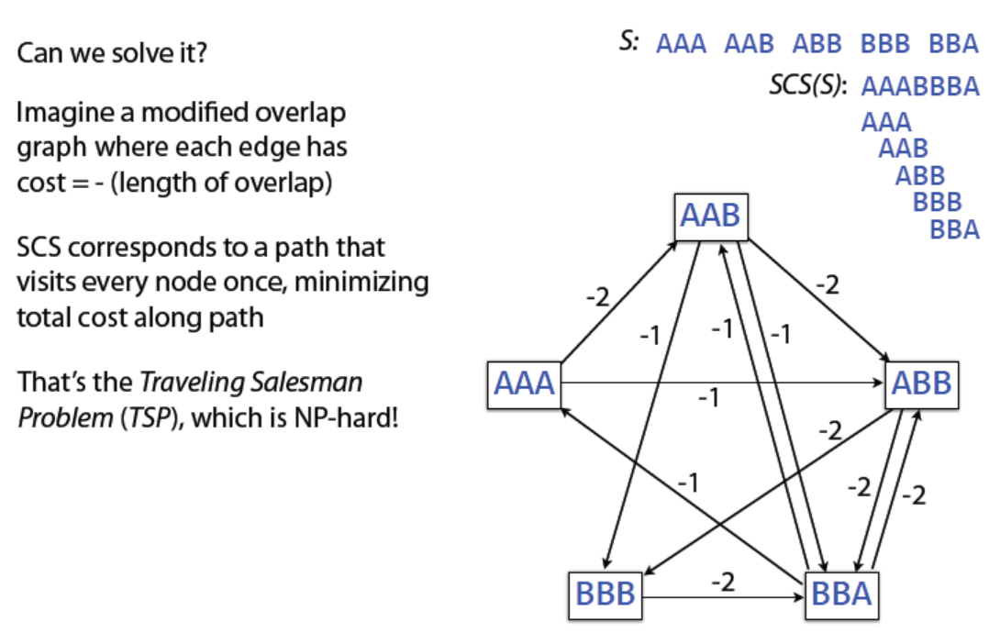
Shortest Common Superstring

Slide 9
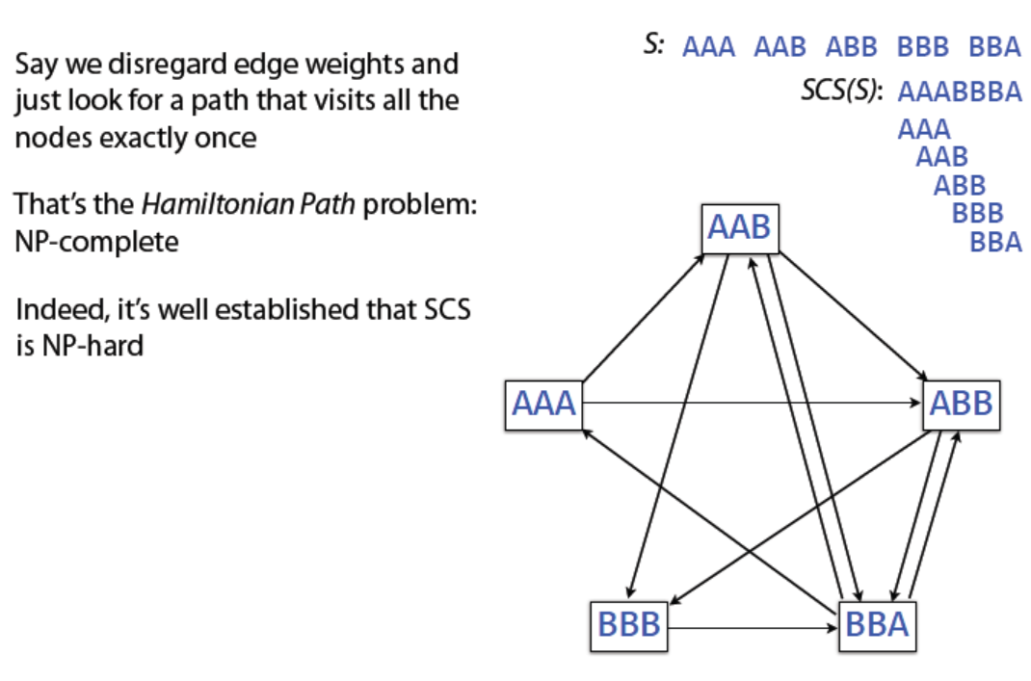
Shortest Common Superstring

Slide 10
Greedy Shortest Common Superstring
Non-optimal superstrings can be found with greedy algorithm
At each step, greedy algorithm chooses longest overlap between two reads. Ties are resolved arbitrarily.

Slide 11
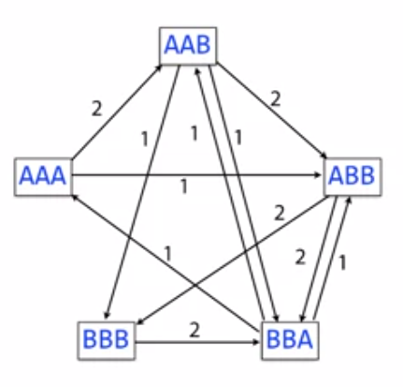
Greedy SCS

Slide 12
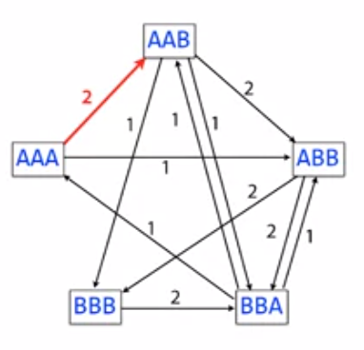
Greedy SCS

Slide 13
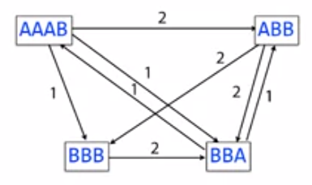
Greedy SCS

Slide 14
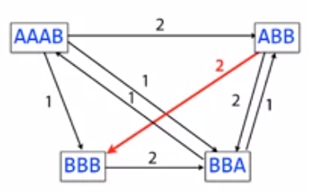
Greedy SCS

Slide 15
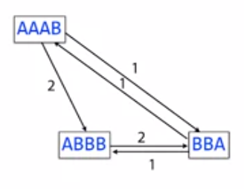
Greedy SCS

Slide 16
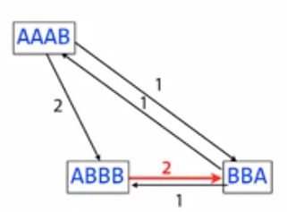
Greedy SCS

Slide 17
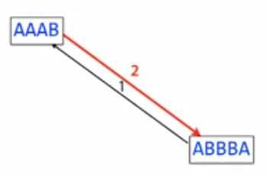
Greedy SCS
AAABBBA

Slide 18
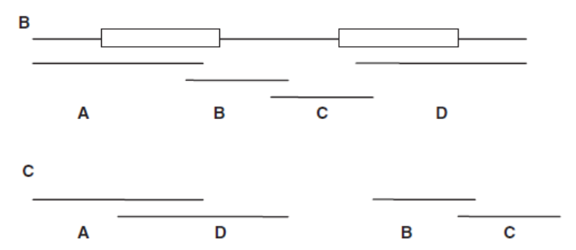
Greedy Shortest Common Superstring: issues
Correct Assembly with two repeats (boxes)
Assembly produced by greedy approach

Slide 19
SCS issues: Repeats
A
R
B
R
C
Collapsing repeats
A
R
B
C

Slide 20
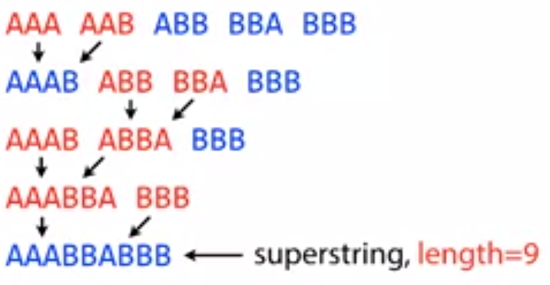
Greedy SCS: failure scenario

Slide 21
Greedy SCS: failure scenario
AAA AAB ABB BBA BBB
AAA AAB ABB BBBA
AAA AABB BBBA
AAA AABBBA
AAABBBA
Breaking the ties differently results in an optimal solution!

Slide 22
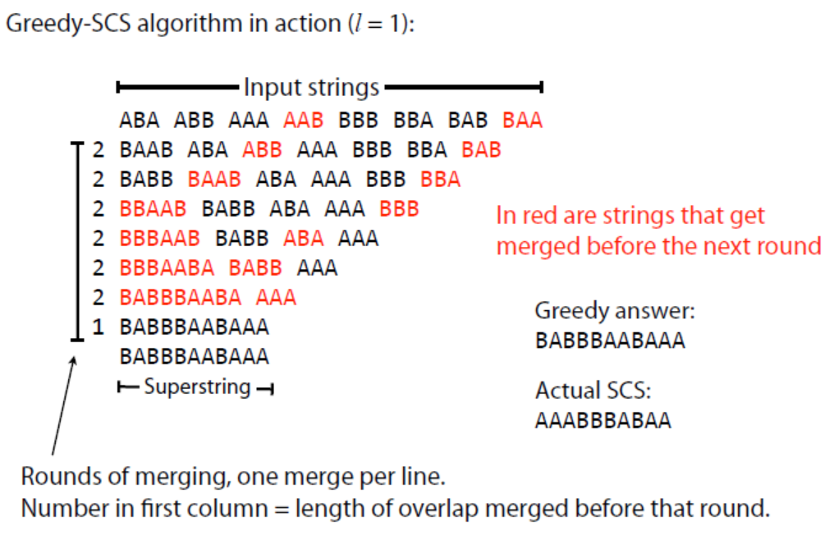
Greedy Shortest Common Superstring

Slide 23
Greedy Shortest Common Superstring
Greedy algorithm is not guaranteed to choose overlaps yielding SCS
But this is a good approximation (ratio ~ 2.5), i.e. the superstring obtained by the greedy algorithm won’t be more than ~2.5 times longer than the true SCS (Dan Gusfied).

Slide 24
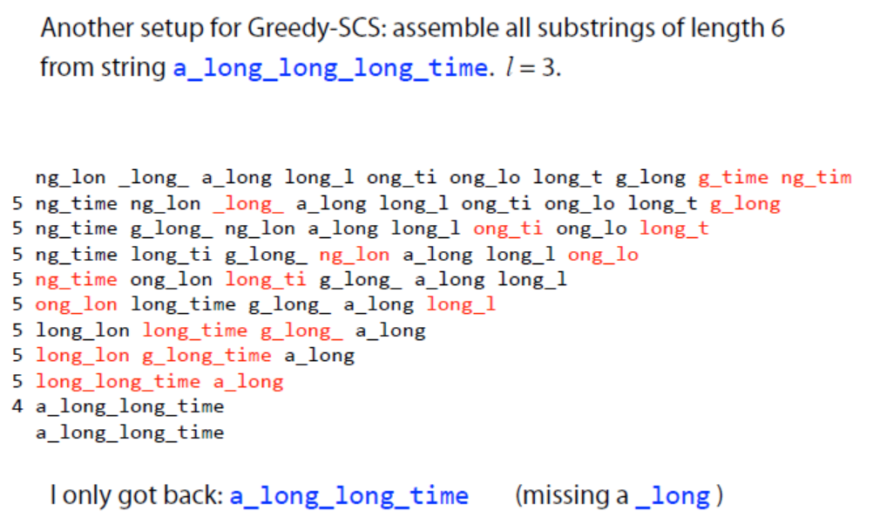
Greedy Shortest Common Superstring

Slide 25
Greedy Shortest Common Superstring
What happened?

Slide 26
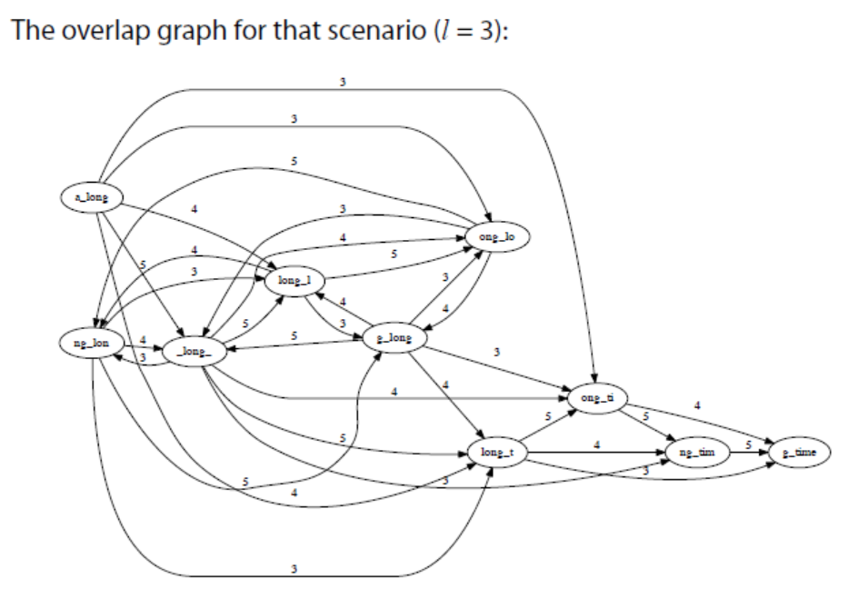
Greedy Shortest Common Superstring

Slide 27
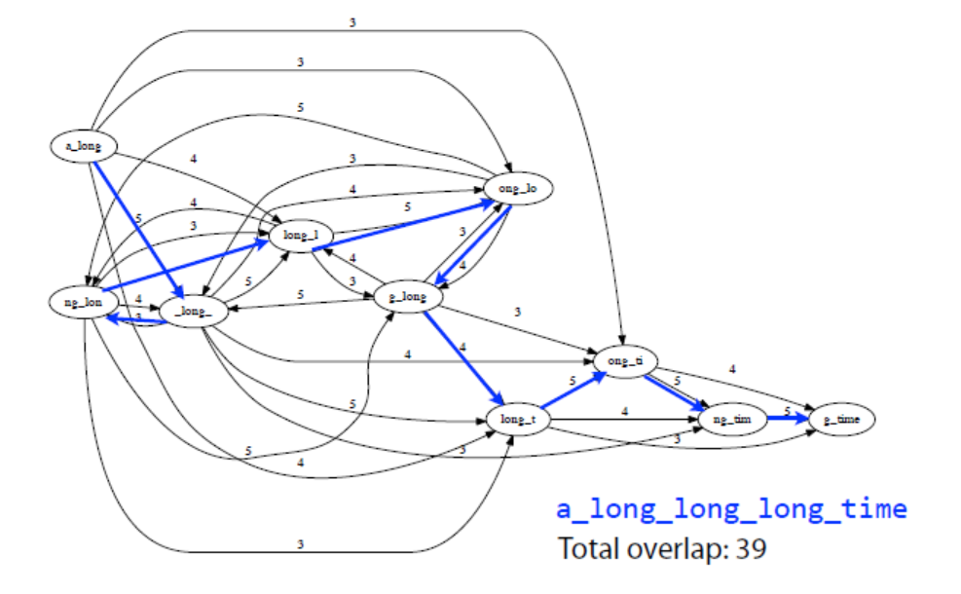
Greedy Shortest Common Superstring

Slide 28
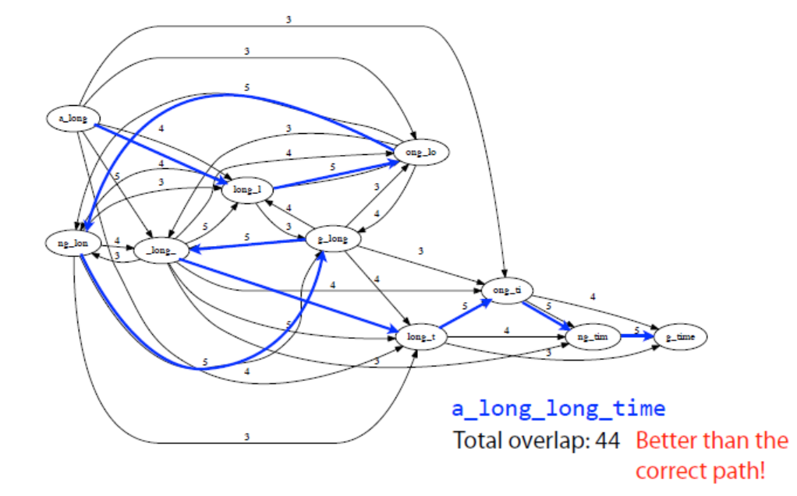
Greedy Shortest Common Superstring

Slide 29
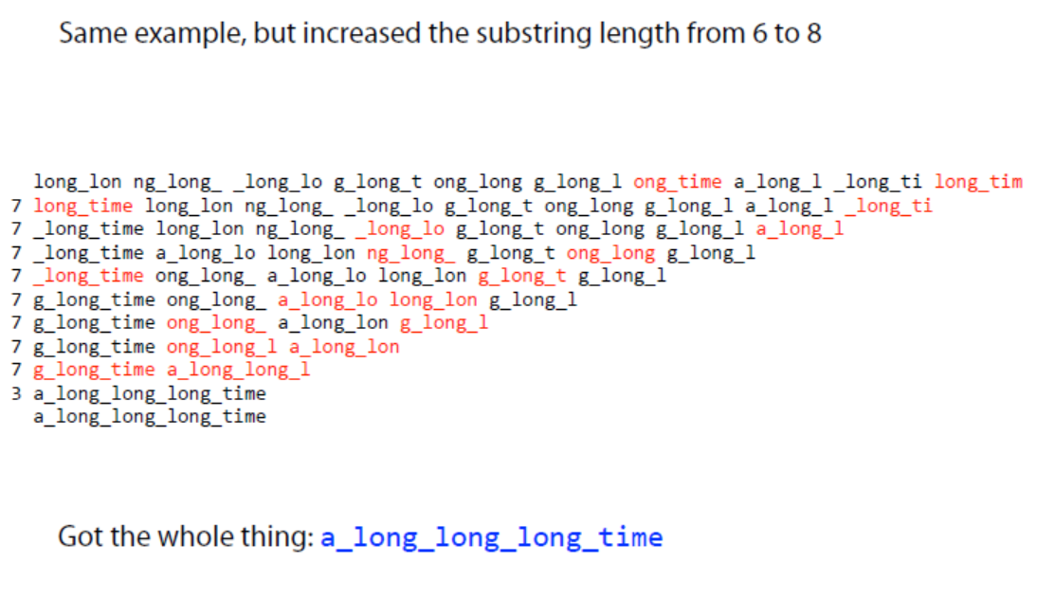
Greedy Shortest Common Superstring

Slide 30
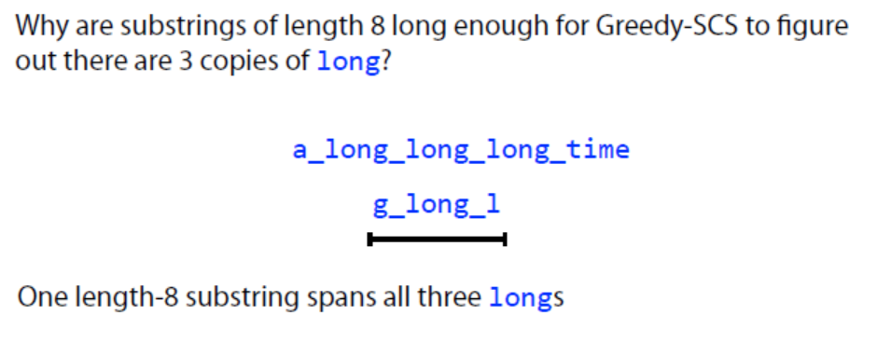
Greedy Shortest Common Superstring

Slide 31
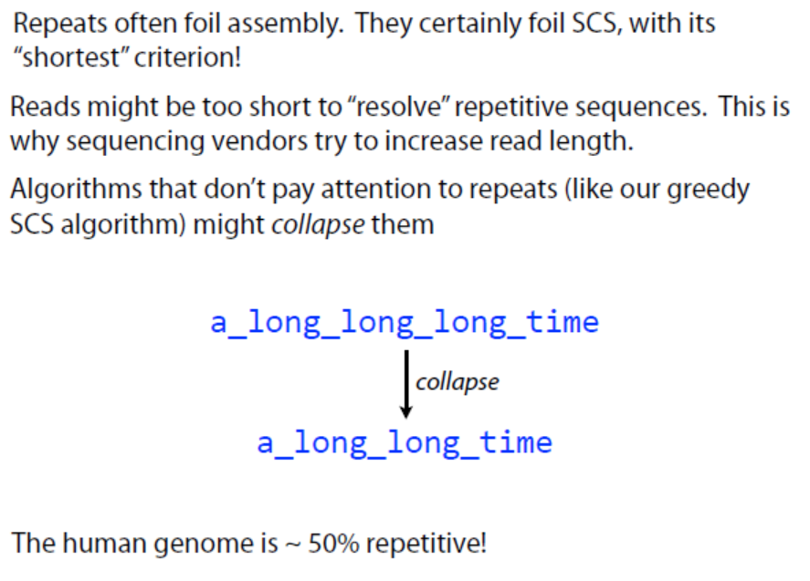
Repeats

Slide 32
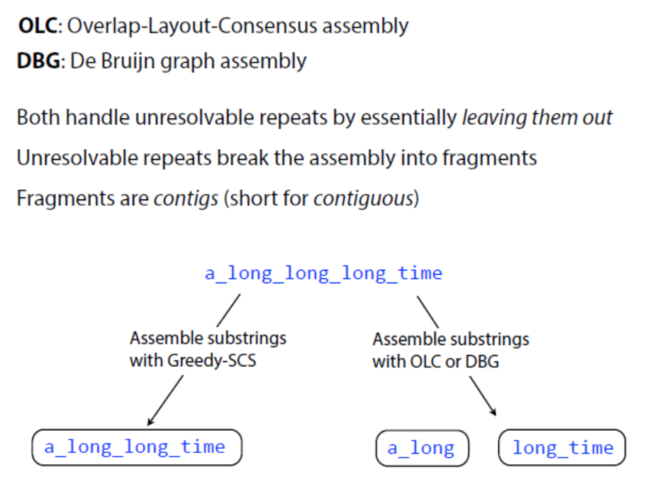
Alternatives

Slide 33
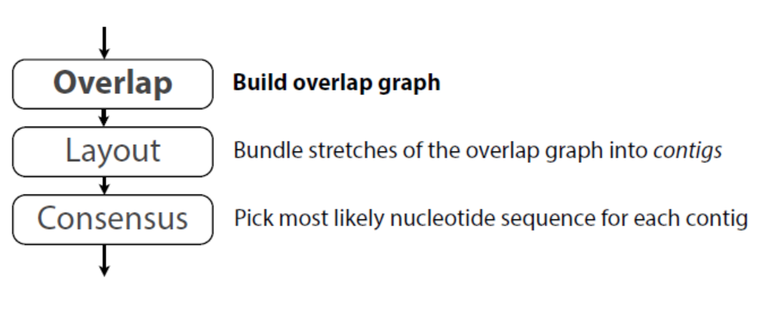
OLC
Finding potentially overlapping reads
Finding the order of reads
Deriving the DNA sequence from the layout

Slide 34
De Bruijn graph
A formulation conceptually similar to overlapping/SCS, but has some potentially helpful properties not shared by SCS.

Slide 35
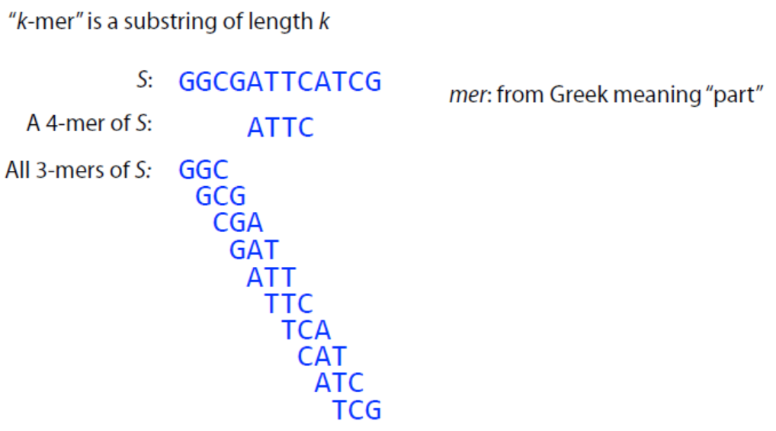
De Bruijn graph: k-mer

Slide 36
De Bruijn graph
Vertices are the prefixes or suffices (of length k-1) that appear in some k-mer in some read, and directed edges are defined by overlap of k-2 nucleotides.
Note that every edge v->w implies a k-mer!

Slide 37
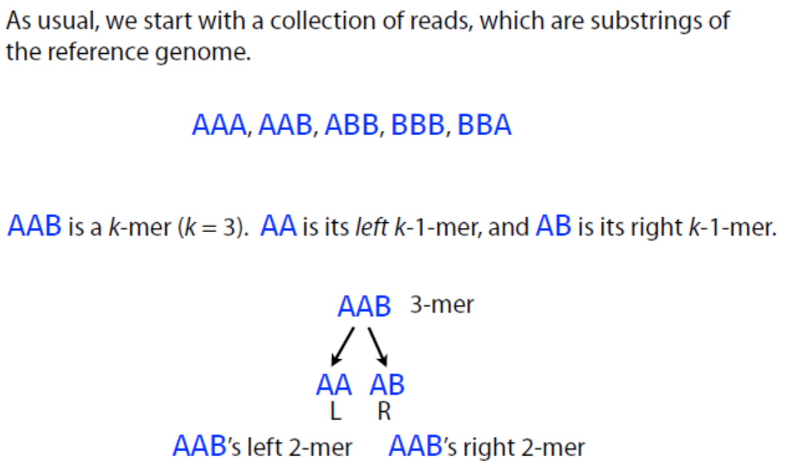
De Bruijn graph: construction

Slide 38
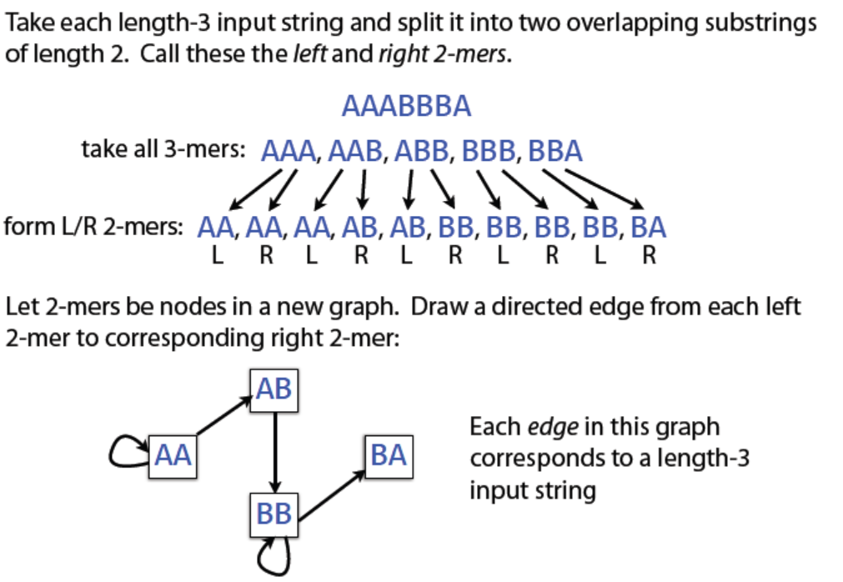
De Bruijn graph: construction

Slide 39
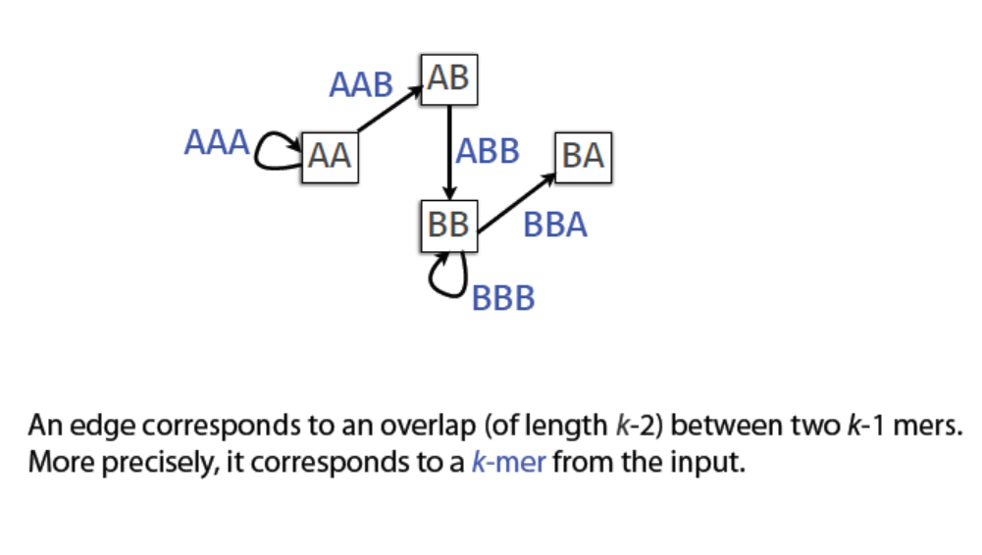
De Bruijn graph: construction

Slide 40
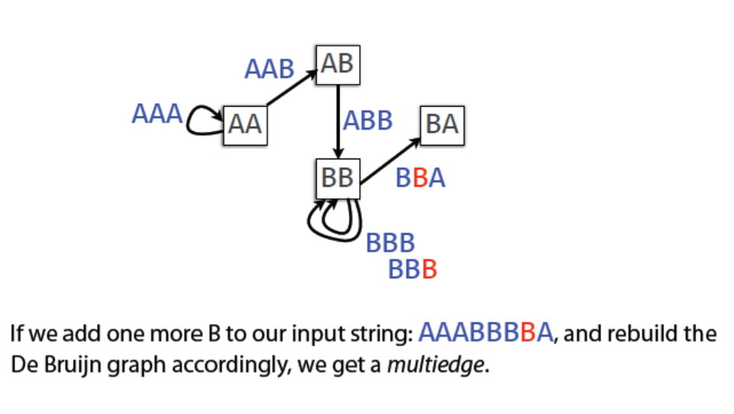
De Bruijn graph: k-mer

Slide 41
De Bruijn graph: k-mer
Small values of k produce small graphs
Does not require all-pairs overlap calculation!
Efficient algorithms exist for finding Eulerian path
Also produces fragmented assemblies (even shorter contigs)

Slide 42
De Bruijn graph: assembly
An Eulerian path is one that goes through every edge exactly once
It is easy to see that if a graph has an Eulerian path, then all but 2 nodes have even degree. The converse is also true, but a bit harder to prove.
For directed graphs, the cycle will need to follow the direction of the edges (also called “arcs”). In this case, a graph has an Eulerian path if and only if the indegree(v)=outdegree(v) for all but 2 nodes (x and y), where indegree(x)=outdegree(x)+1, and indegree(y)=outdegree(y)-1.

Slide 43
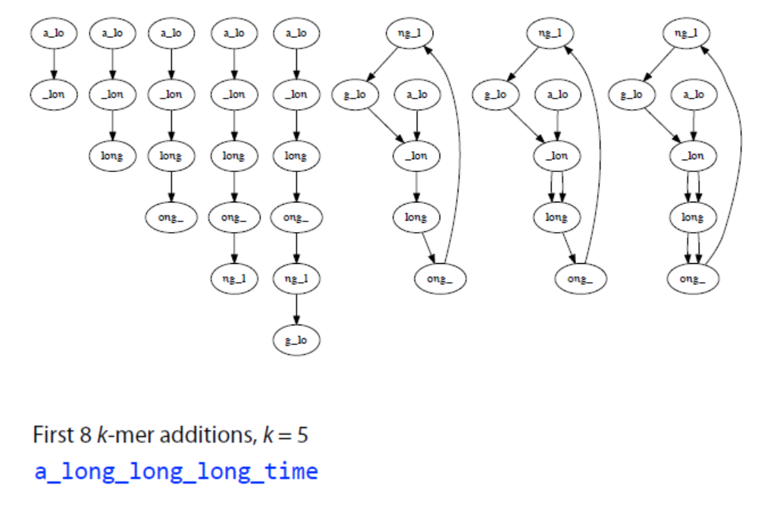
De Bruijn graph: example

Slide 44
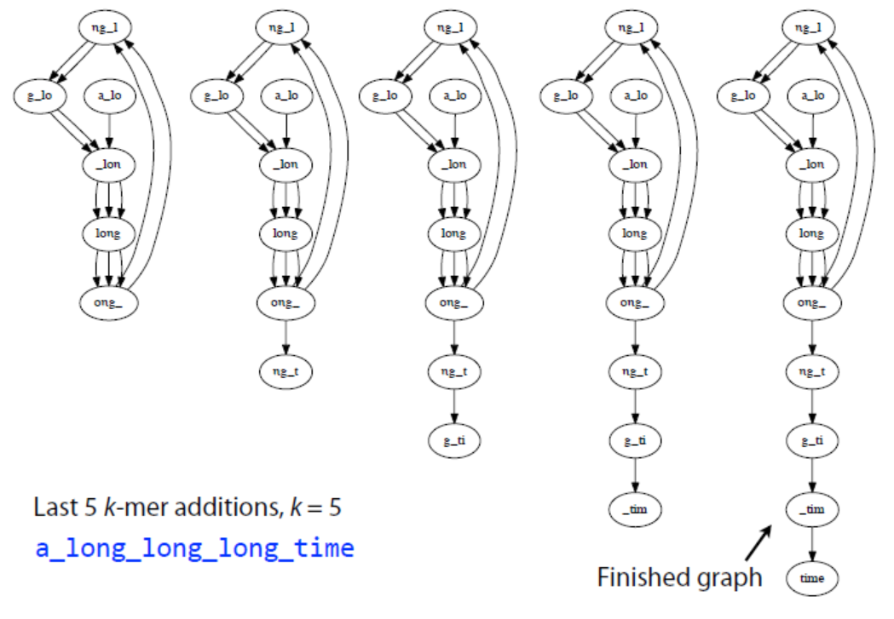
De Bruijn graph: example

Slide 45
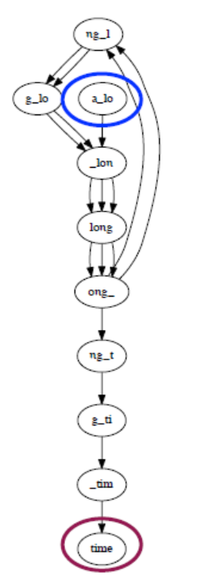
De Bruijn graph: example

Slide 46
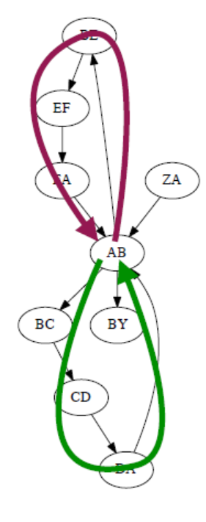
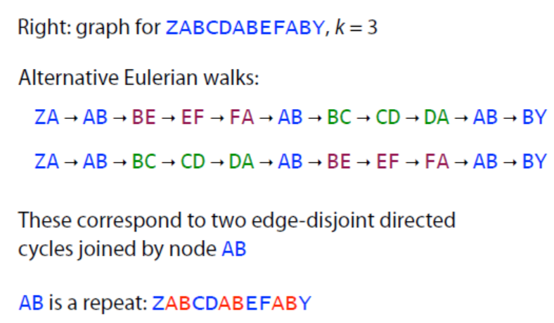
De Bruijn graph: failure scenario

Slide 47
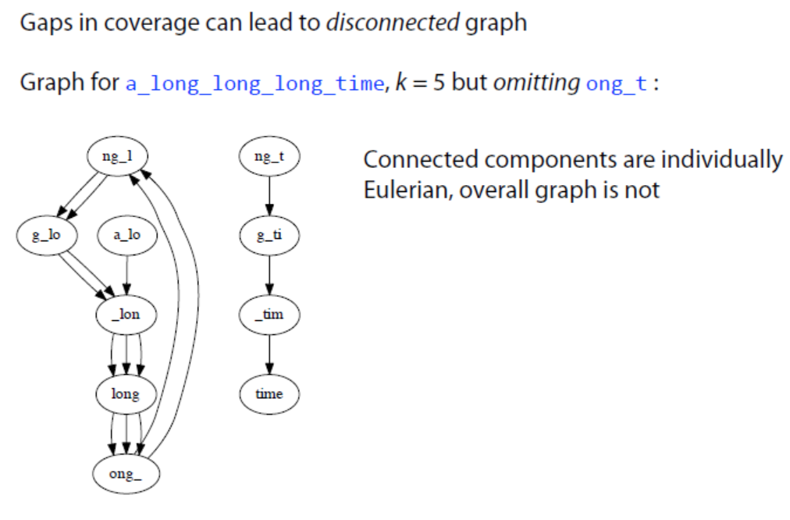
De Bruijn graph: failure scenario

Slide 48
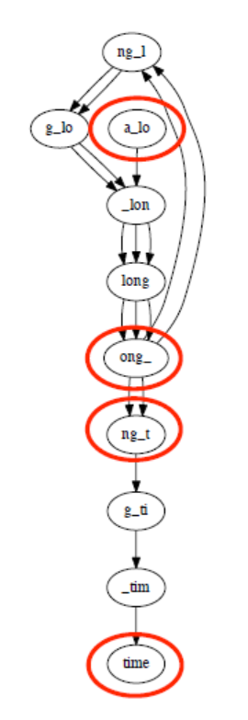
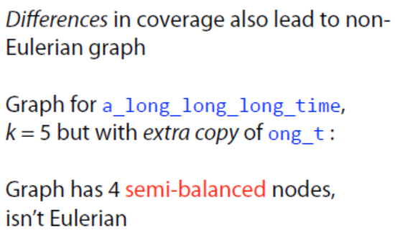
De Bruijn graph: failure scenario

Slide 49
De Bruijn graph: k-mer
Small values of k produce small graphs
Does not require all-pairs overlap calculation!
Efficient algorithms exist for finding Eulerian path
Also produces fragmented assemblies (even shorter contigs)
Sensitive to sequencing errors
Long range connectivity information is lost for small k

Slide 50
Genome assembly
Genome assembly is not as simple as we’ve described…
…but finding Eulerian paths is still the basis of most genome assembly methods!

